Slide 1


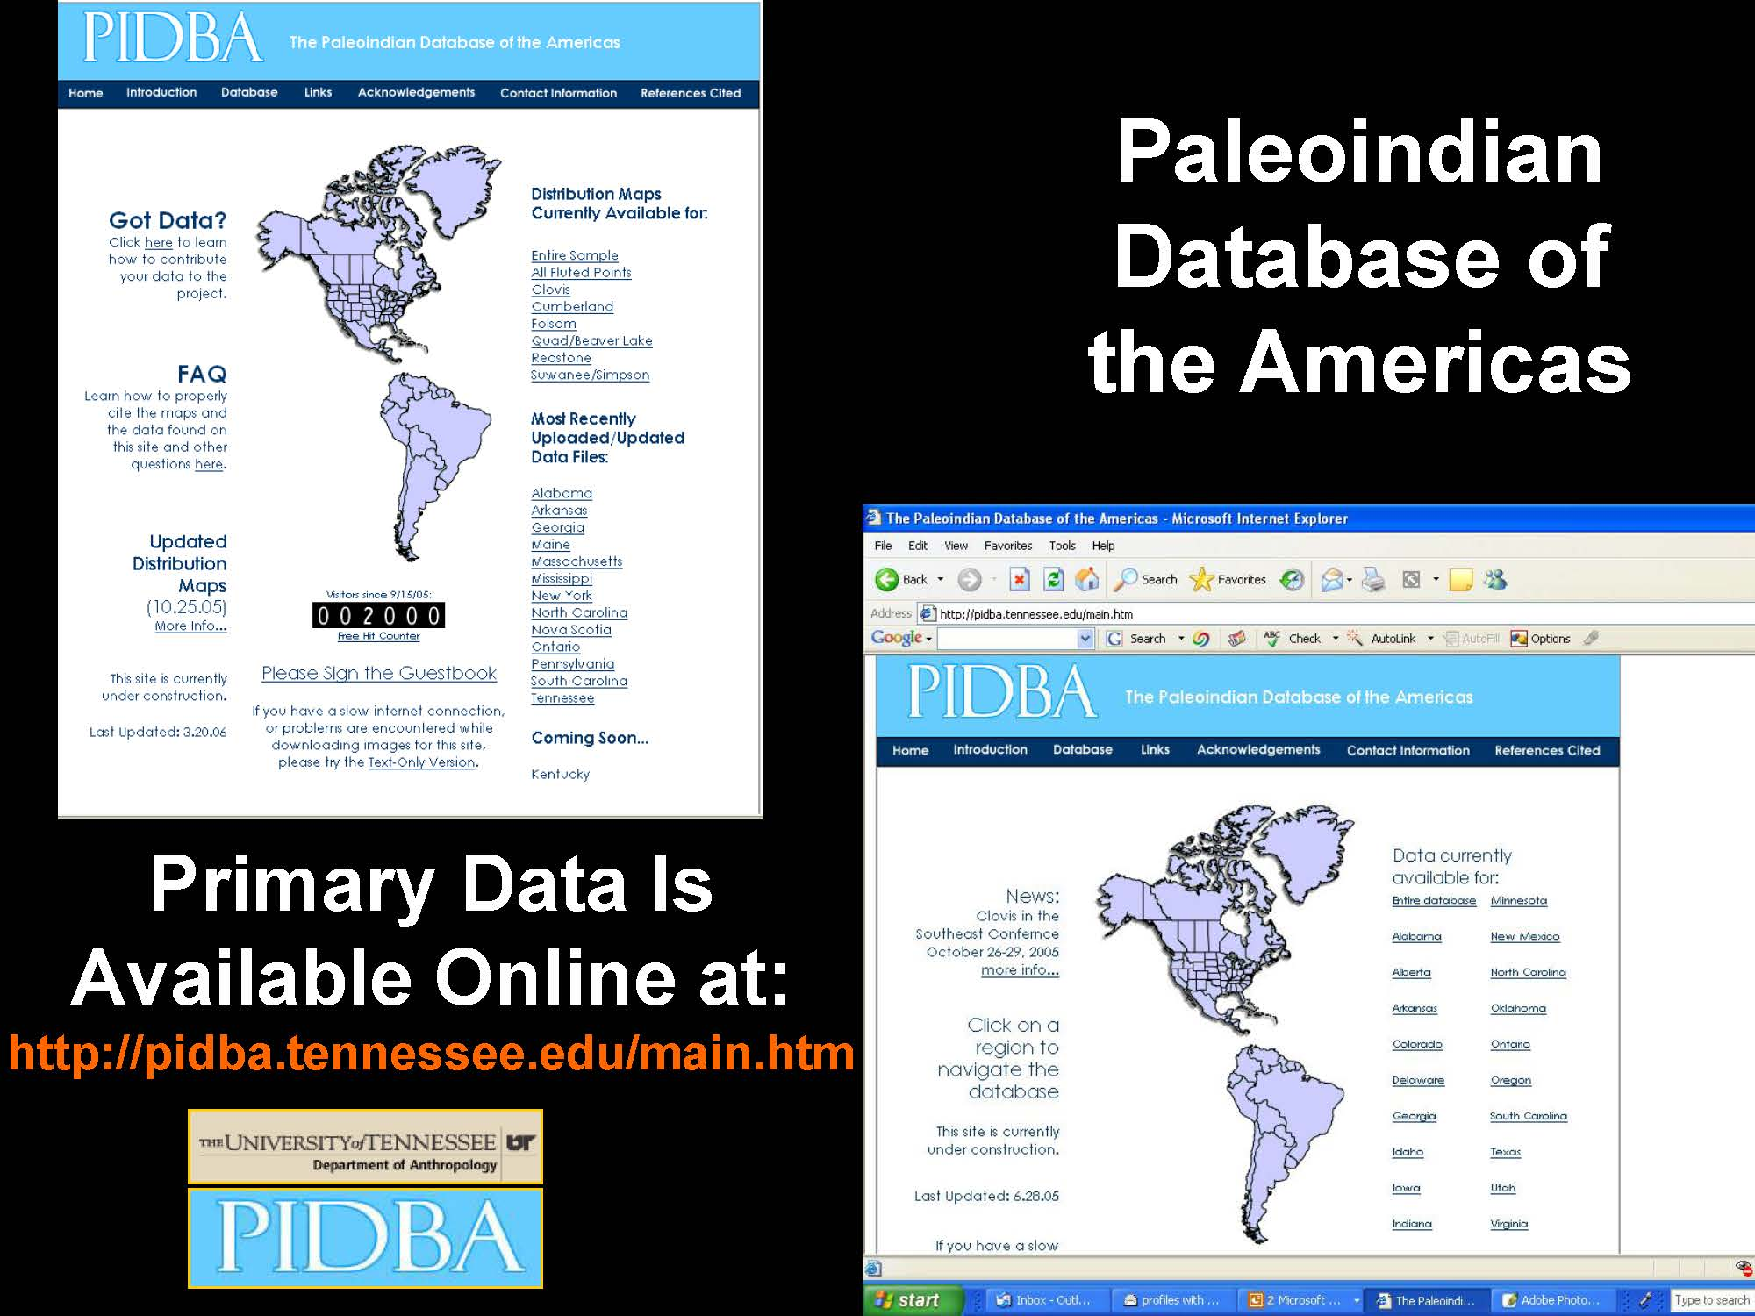

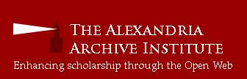
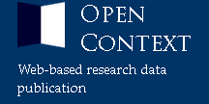
Bridging the gaps:
Assessments and plans for American federation
strategies and data standards to unite
state-level archaeological databases
Joshua J. Wells, PhD, RPA
Dept. of Sociology and Anthropology
& Department of Informatics
Stephen J. Yerka, MA, RPA
University of Tennessee, Knoxville
Archaeology Research Laboratory
NSF Awards
#1216810
#1217240
Notes:
PROPS TO DAVID G. ANDERSON (WAITING FOR ROO JERKY) AND SARAH KANSA. ALSO IU FACULTY RESEARCH GRANT. THANKS TO SHAWN, ADELA, AND THE FAIMS TEAM FOR VISION AND HOSPITALITY. OF COURSE THE NSF.
TWO YEARS
SHARED VISION OF NATIONAL DATASET USED FOR RESEARCH AND PUBLIC OUTREACH
15-20 STATES, 1.5-2 MILLION SITE FILES
PROJECT JUST BEGINNING
INTERSECTION OF ACTIVITIES AND INTERESTS ACROSS THREE DISPERSED RESEARCH SITES
SIMILARITIES WITH FAIMS GOALS AND EXPERIENCE

Slide 2

Bridging the gaps:
Assessments and plans for American federation
strategies and data standards to unite
state-level archaeological databases

Slide 3
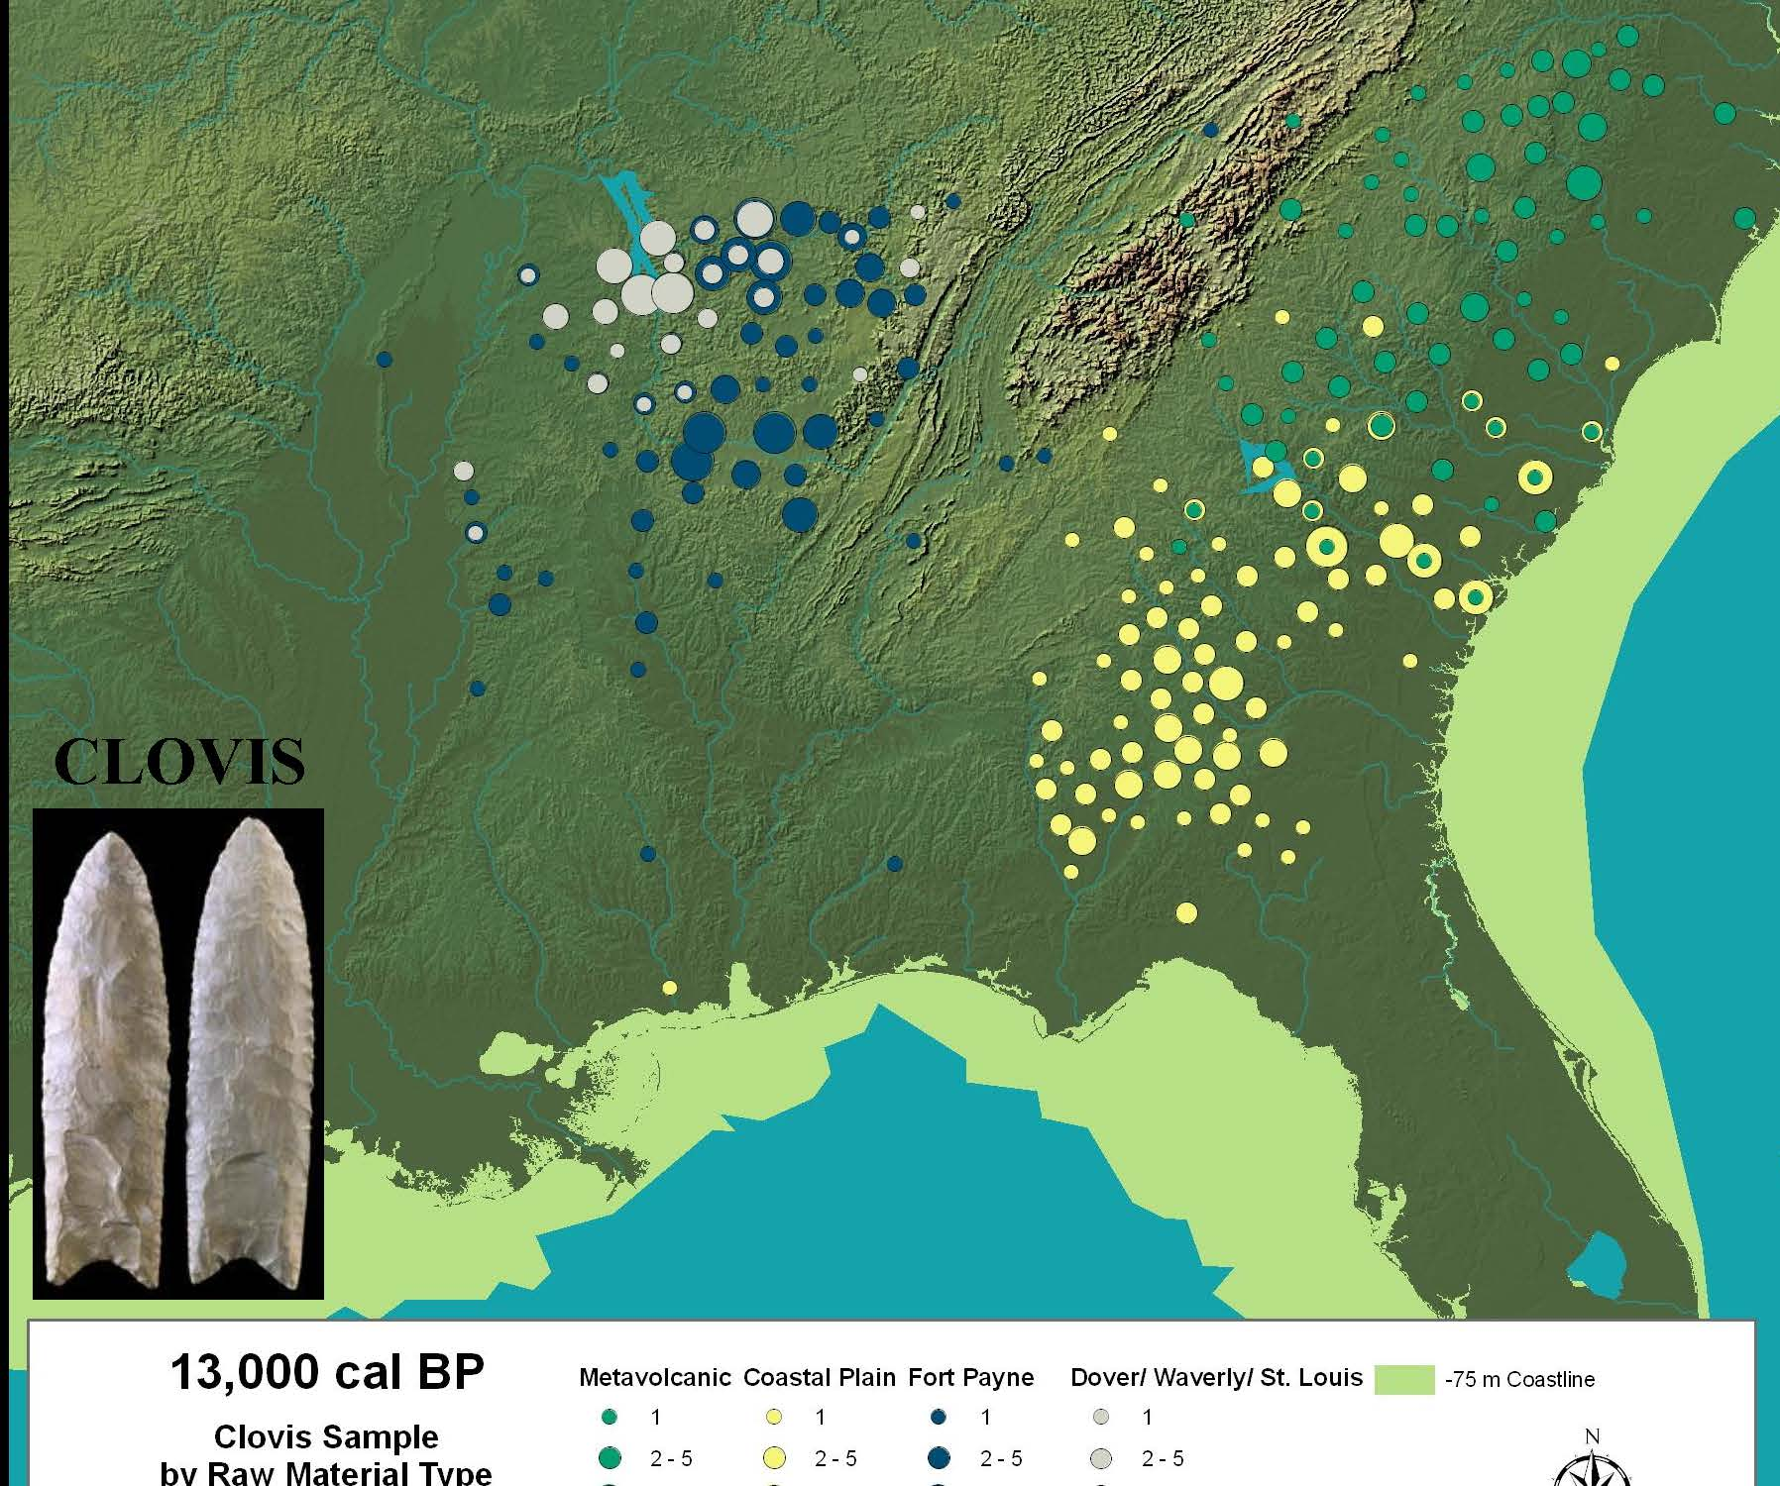
Notes:
STEVE PIDBA: 29000+ locations, 15000+ attribute data instances, 7000+ items with image files. Adding on average about 1000 data entries a year

Slide 4
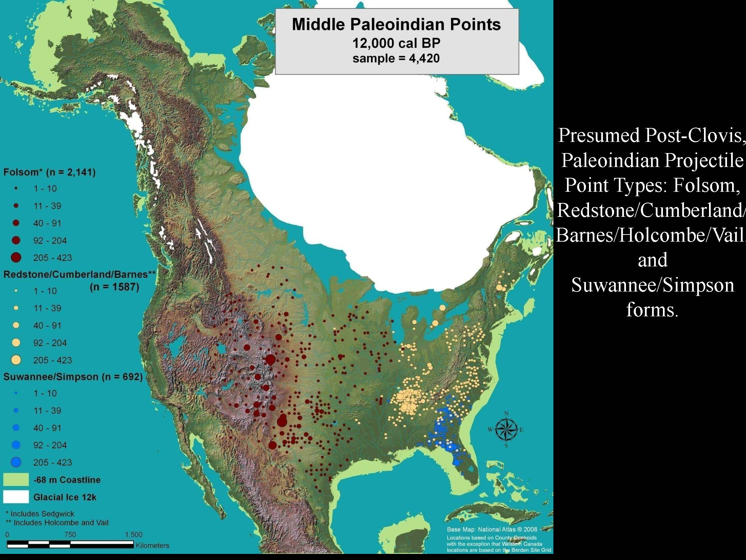
Notes:
Steve: Integrate with environmental, geological and geographic data.
JOSH PIDBA IS A DATABASE AND A COMMUNITY

Slide 5
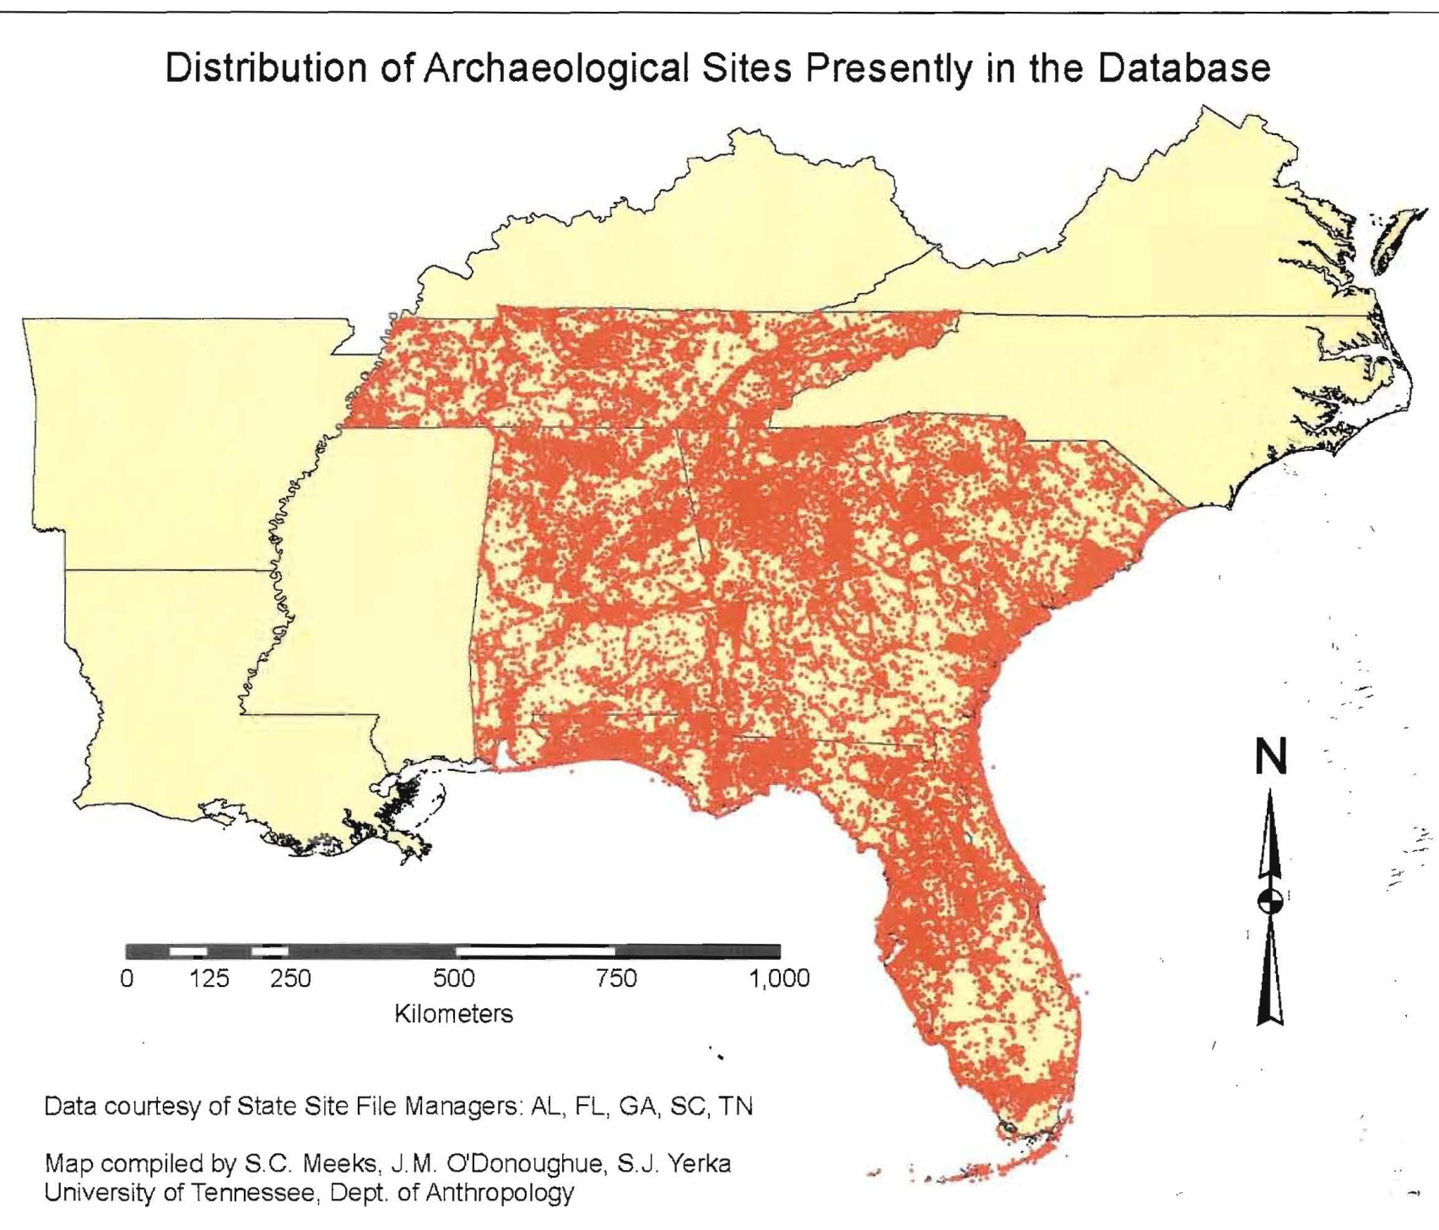
Notes:
STEVE – PIDBA EXPERIENCE INSPIRED TEAM TO MOVE INTO LARGE DATASETS

Slide 6
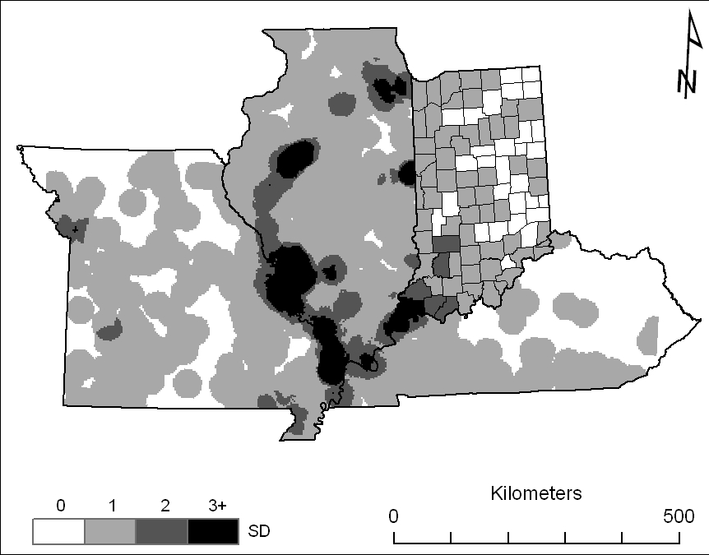
Density map of 4593 locations defined by site records. Continuous density for 3922 locations across MO, IL, and KY with analytical radius of 2.5 km. County-level density for 671 IN locations. Standard deviation shading is the same for both sets, however they are not comparable.
Notes:
JOSH - SIMULTANEOUSLY STARTED A MASSIVE SURVEY OF SITE-FILE DATA MANAGEMENT PRACTICES AND HAD BEGUN INVESTIGATING DATA FILES FOR INTEROPERABLE CONCEPTS AND STRUCTURES

Slide 7
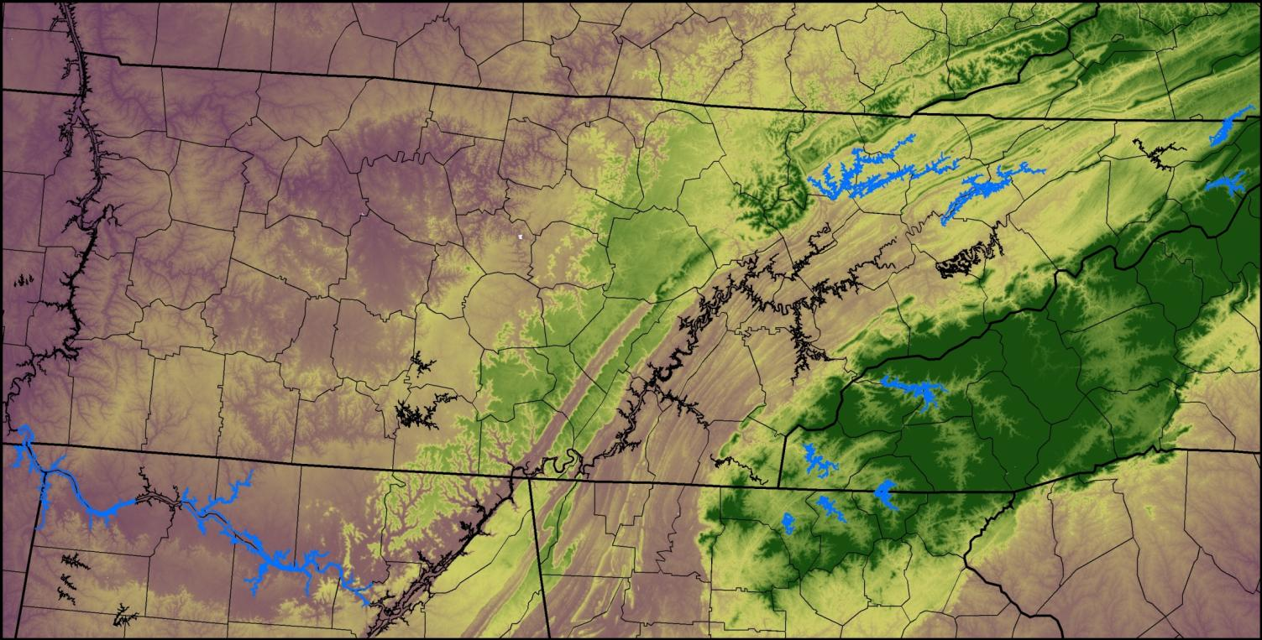
Eleven ROC Reservoirs in Six States
+1,900 site survey forms
+1,000 site sketch maps
+10,000 GPS locations
10 GB of digital photographs
26 GB of GIS data and models (internal and external)
+19,000 artifacts cataloged
Faunal, Botanical, Geoarchaeological, and Archaeometery specialized analyses
Six state site file formats
The client requires access to raw data.
South Holston
Norris
Watauga
Cherokee
Fontana
Hiwassee
Wheeler
Chatuge
Blue Ridge
Pickwick
Nottely
Notes:
STEVE – BEGAN CONSIDERING AN IDEALIZED DATABASE WORKFLOW FOR PROJECTS FROM INCEPTION TO FIELD TO LAB TO ARCHIVE

Slide 8
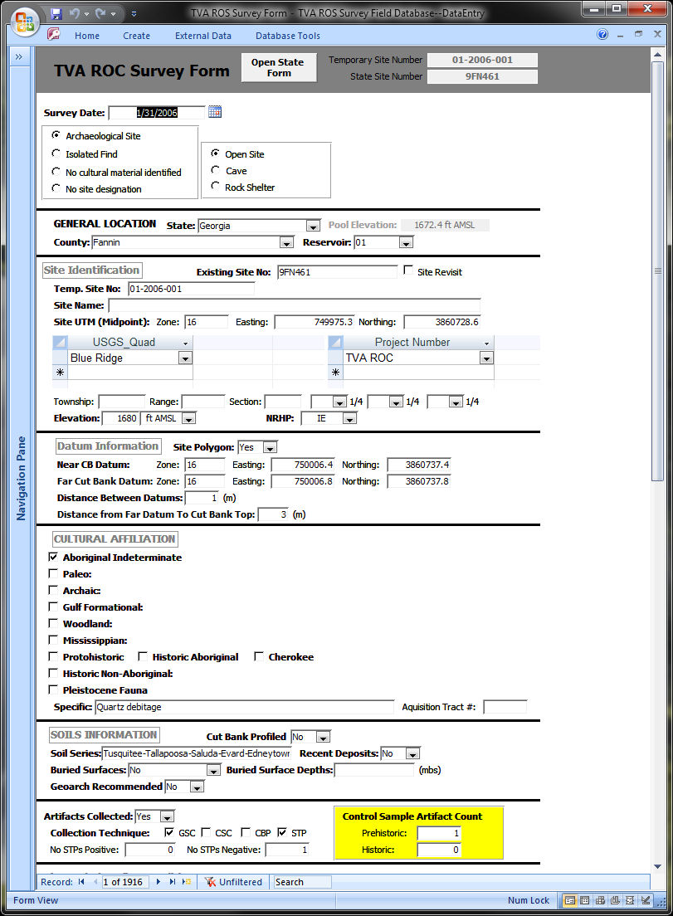

Digital Version of the Standardized Site Survey Form
A form based interface is created to allow data entry.
Notice the similarity between digital and paper forms in terms of data flow.
Dropdown combo list provide validation and reduce data entry error
ARL decided against trying to use field computers for point of access data entry since conditions were potentially difficult , but the interface could easily be brought into the field on any device with the appropriate software.

Slide 9
Six entities make the core of the database system design
Project
Site
Site Survey
Context
Lot/BCL*
Artifact Catalog Item
Object-Oriented Relational Database Basic Objects
* Bag Check List

Slide 10
Database Design ERD
Project
(One or zero)
Site
Crow’s Foot notation used to represent a one-to-many relationship where the “parent table” can optionally have from zero to any number of related records, and the “child table” must have one, and only one entry that corresponds in the parent table
generates
references
Site Survey
This relationship can be interpreted in the following way: A project may (or may not) generate many site surveys, and a site survey must be generated by a single project.
Context
encounter
Lot
contains
Artifact Catalog Object
contains

Slide 11
ARL-TVA ROC Shoreline Survey (Site-Provenience/Project Model illustrated)
Project # | Account # | Project Name | Start Date | Principal Investigator | Client/Granting Agency
1 | 000000-000-000 | TVA ROC | 1/1/2005 | Nicholas P Herrmann and Mathew D Gage | TVA (Cultural Resources)
Project
Project Number | integer (PK)
Account Number | integer
Project Name | string (255)
Start Date | date
Principal Investigator | String (255)
Project Director | String (255)
Client Number | Integer (FK)
Level of Investigation | String (60)
Many of the attributes ARL records are not displayed in this and the following figures for the sake of legibility.
(PK) = Primary Key or Alternate Key
(FK) = Foreign Key
(see Codd 1970; Rob and Coronel 2000; and Whitten et al 2000)

Slide 12
Artifact Cataloging
Different artifact types are arranged as a hierarchy in much the same way that context types were treated above.
Ceramic
Artifact ID # (FK)
Measure 1
Measure 2
Context
Context #
Lot
Lot Item #
Context #
Sample Type
Excavators
Artifact Catalog Object
Artifact ID #
Lot Item #
Artifact Type
Lithic
Artifact ID # (FK)
Measure 1
Measure 2
Paleoethnobotany
Artifact ID # (FK)
Measure 1
Measure 2

Slide 13
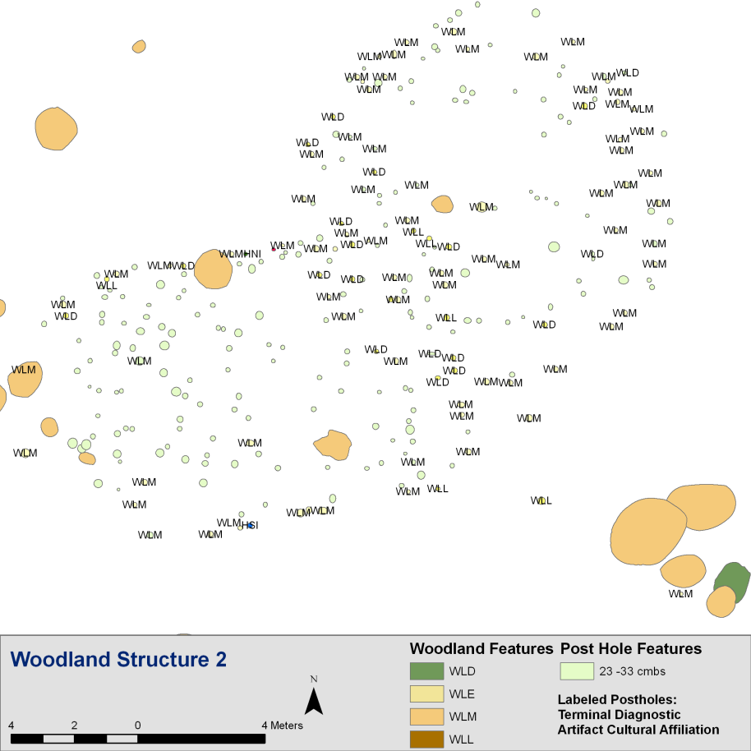
Example of GIS Integration
Applying a terminus post quem query to excavated postholes revealed an overwhelming trend when applied to structures at the Townsend Archaeological Site, Tennessee. These structures could not have been built before the Middle Woodland Period.
To perform this query a join was simply created between the artifact table and the GIS object Excavated Post Hole Features.
WLM = Middle Woodland WLD = General Woodland
WLL = Late Woodland WLE = Early Woodland

Slide 14
Density map of 4593 locations defined by site records. Continuous density for 3922 locations across MO, IL, and KY with analytical radius of 2.5 km. County-level density for 671 IN locations. Standard deviation shading is the same for both sets, however they are not comparable.
Notes:
JOSH – SO HOW DO EXISTING WORKFLOWS RESULT IN THE DATA AS WE CURRENTLY SEE IT? UNDER THIS MAP IS A LOT OF DETAILED INFORMATION ABOUT SITE STRUCTURE AND INVESTIGATIVE STRATEGIES

Slide 15
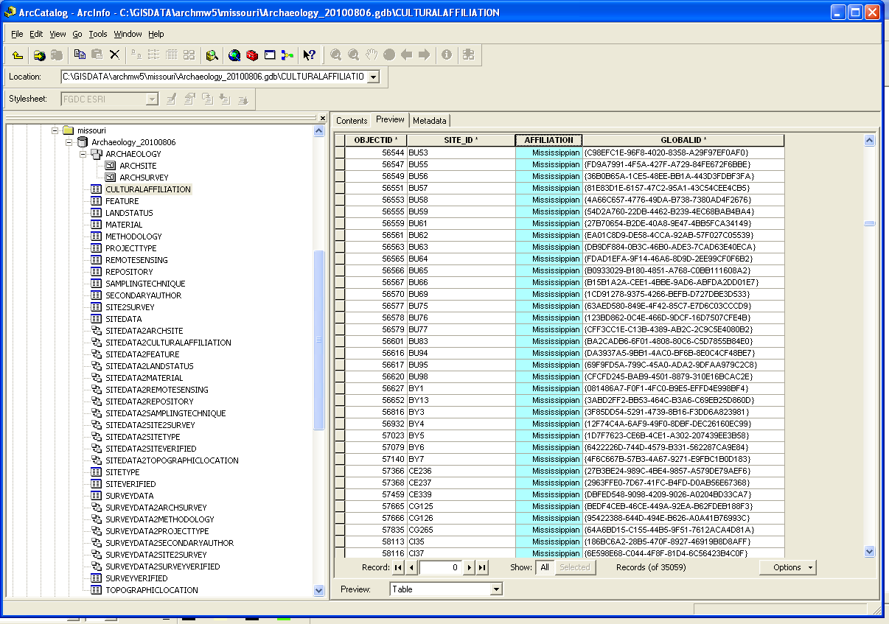
Missouri relational database tables and shapefiles
within ESRI geodatabase

Slide 16
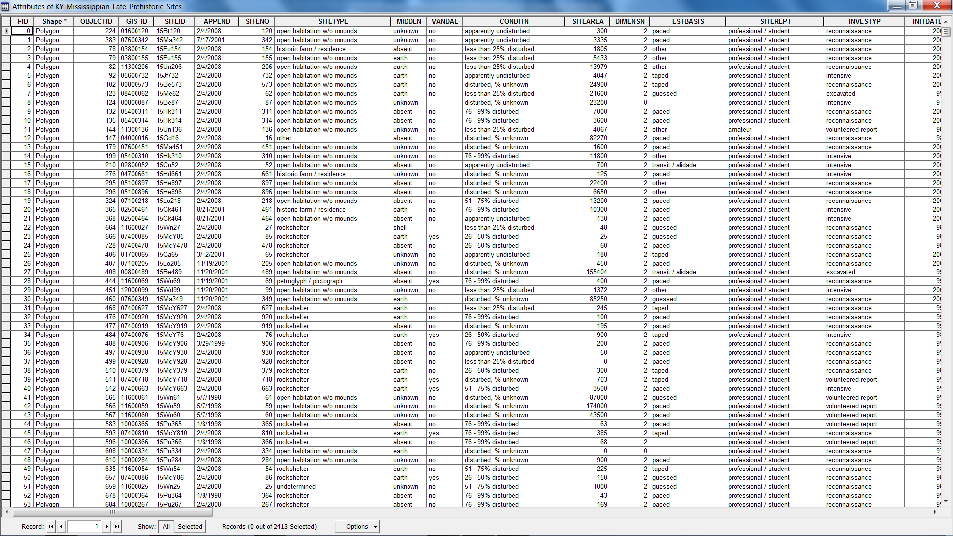
Kentucky database attributes, including string coded column for
site type, and similar columns describing project conditions.

Slide 17
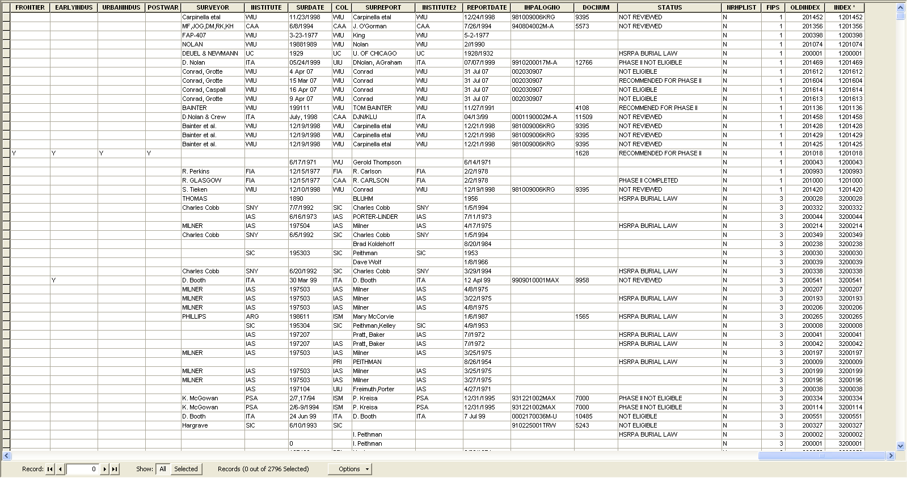
Illinois database attributes, including index primary key for linkage
to other tables, and string coded columns for site status
and NRHP inclusion.

Slide 18
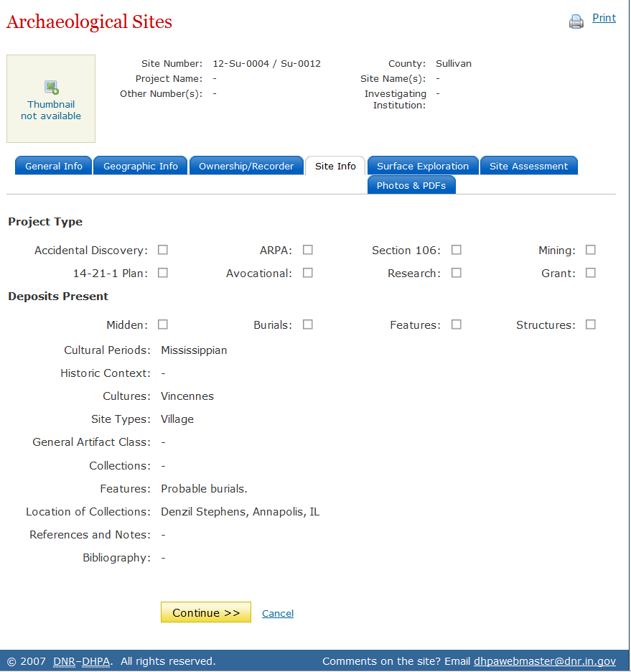
Indiana: SHAARD Verbose Fields

Slide 19
 | Kentucky | Illinois | Indiana | Missouri | Bridge
GIS Location Info | polygon shapefile using state defined (Lambert conformal conic) coordinate system in feet | polygon shapefile using Lambert conformal conic in feet | not directly GIS-ready; UTMs (when present for local zone, in meters) and PLSS | polygon shapefile using UTMs for local zone (in meters) | lat/long in decimal degrees to at least 0.0001 precision (~11m) for points of polygon centroids
Site ID | Smithsonian trinomial system (complete, no hyphens) | Smithsonian trinomial system (county and site number, no hyphens); State index number | Smithsonian trinomial system (complete, hyphenated) | Smithsonian trinomial system (complete, no hyphens) | Smithsonian trinomial system (complete, no hyphens, county in all caps); delimited text field containing associated site IDs for aggregation (e.g. mound & village)
Site Type Variables (see text for distribution of variables through specific database attributes) | Cave rockshelter cemetery – open habitation – – earth mound mound complex stone mound isolated find x petroglyph/pictograph undetermined x midden other | rock shelter – cemetery ph cemetery habitation – – mound mounds x isolated find x pictographs unknown quarry x other | x – cemetery burial camp farmstead village mound – – isolated find lithic scatter x undefined x x x | cave/rockshelter – cemetery/mortuary – extraction camp habitation (prehistoric) – mound/cairn – – x lithic scatter rock art not reported quarry x other | [subterranean] – [burial] (int field) – [camp] OR [habitation] (int field) – [mound] (int field) OR [cairn] (int field) – [isolate] [lithic scatter] [rock art] [undefined] [quarry] [midden] [other] (text field)
Site attribute representation for minimalist consideration.
Notes:
JOSH – ONTOLOGICAL BRIDGES THAT CAN BE RELATED TO STATE SITE FILE STRUCTURES THROUGH MANAGEMENT PRACTICES DERIVED FROM STEVE’S MODEL, ADDING ANOTHER LAYER OF INTERPRETIVE INFORMATION TO THE SET BUT PRESERVING THE CHARACTER OF THE ORIGINAL DATA

Slide 20
 | Kentucky | Illinois | Indiana | Missouri | Bridge
Previous Investigation Variables (see text for distribution of variables through specific database attributes) | excavated; intensive; reconnaissance; volunteered report | 1m x 1m; 2m x 2m test unit; auger; core; excavation; machinery; pedestrian; phaseii testing; private; remote; shovel test; test squares; test unit | numerous attribute fields for binary choice and text descriptions related to methods of investigation | pedestrian; shovel testing; auger probe; mechanical stripping; plowed; literature search transects; test pits; photographic analysis; excavation; interviews; soil core; not reported; archaeology; phase ii; phase iii; remote sensing technique | sub-phase 1 and phase 1-3 equivalents represented by integers 0 through 4
Site Informational Quality | NRHP relationship described with range | NRHP inclusion as boolean Y/N choice, no gradient | NRHP and state-level historic potential described with range | NRHP relationship described with range | NRHP quality represented by [listed], [ineligible], [possible], and [undefined]
Cultural Affiliations | Mississippian general category and spatiotemporal variations defined textually in one attribute field | Mississippian and Upper Mississippian general categories defined as boolean with [Y] or null | Mississippian general category and spatiotemporal variations textually defined; local archaeological cultural phases defined textually in separate attribute field | Mississippian general category and temporal variations textually defined | [Mississippian] AND [transitional] OR [middle] OR [late] OR [undefined] AND integer dates [int early] AND [int mid] AND [int late] AND phase or culture [name]
Site attribute representation for expanded informational value.

Slide 21
Notes:
JOSH – SITES WITH CODING THAT WOULD INDICATE HABITATION, COMPARE REGIONAL SETTLEMENT ACROSS BOUNDARIES – THIS IS SUPER SIMPLE

Slide 22
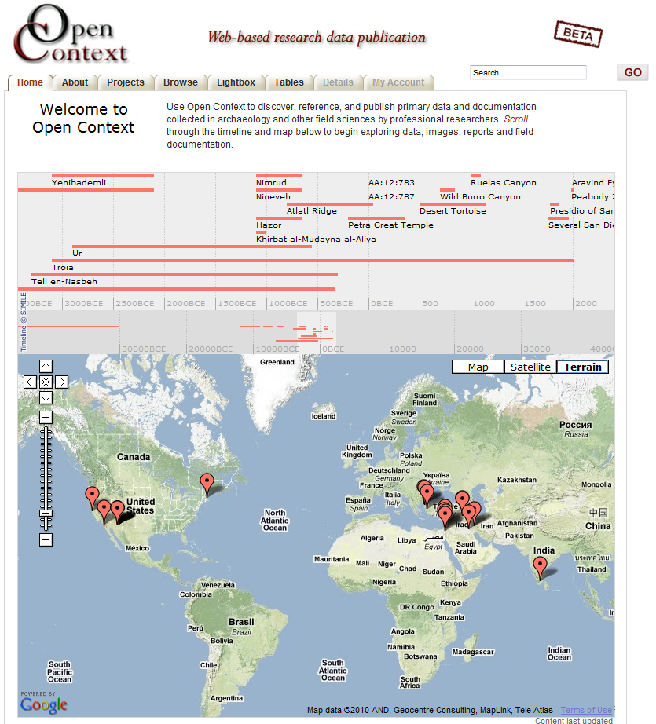
How Linked Data Will Help Manage Information
URIs published through Open Context for archaeological sites can be connected with
Collections
Reports and other Literature
Environmental Data
Infrastructural Data
Political & Demographic Data
Tourism & Education Portals
Potential Repositories
California Digital Library
tDAR
Federal Preservation Institute
Notes:
JOSH – HOW OPEN CONTEXT CAN HELP

Slide 23
730 DAYS OF ACTION
PHASE 1 - ORGANIZATION
Identification of data sets and structures
Identification of data testers
PHASE 2 – COLLECTION & INTEGRATION
Security
Assessment
Ontological bridging
PHASE 3 – TESTING THE LIMITS
Collaborative research testing
Public outreach downloads
F2F workshop for managers, testers
outsourced to Ross and Sobotkova
PHASE 4 – DEMO BEST PRACTICES
Instructions and metadata for reuse
Encourage continuity
FAIMS INTERSECTIONS
Structured workflows for data
Creation
Updates
Targeted ontological bridging
Community standards
archives
access
transfer
Synchronize local control @ national level
Notes:
JOSH 1 & 3, STEVE 2 & 4. JOSH INTERSECTIONS

